Slide 1
INTERVIEW TRAINER ai agent
IBM EDUNET CAPSTONE PROJECT
Presented By:-
Student name : Rajdeep Choudhury
College Name & Department : B. P. Poddar Institute of Management & Technology, Computer Science and Engineering (CSE)

Slide 2
OUTLINE
Problem Statement
Technology used
Wow factor
End users
Result
Conclusion
Git-hub Link
Future scope
IBM Certifications

Slide 3
Problem Statement
Job seekers, from recent graduates to experienced professionals, often face significant stress and uncertainty when preparing for interviews. The process of finding relevant, role-specific questions, practicing answers, and building confidence is unstructured, time-consuming, and often ineffective. Generic online advice fails to address the unique requirements of a specific job role or experience level.
Proposed Solution:
An AI Interview Trainer Agent that uses Natural Language Processing (NLP) and Retrieval-Augmented Generation (RAG) to provide a personalized and comprehensive interview preparation experience. The agent assists users by generating tailored question sets for technical and behavioral rounds, offering model answers structured with proven techniques like the STAR method, identifying key skills to highlight, and providing actionable improvement tips.

Slide 4
Technology used
IBM cloud lite services
Natural Language Processing (NLP)
Retrieval Augmented Generation (RAG)
IBM Granite model

Slide 5
IBM cloud services used
IBM Cloud Watsonx AI Studio
IBM Cloud Watsonx AI runtime
IBM Cloud Agent Lab
IBM Granite foundation model

Slide 6
Wow factors
This agent transforms interview preparation from a stressful task into a structured and confidence-boosting coaching session. It significantly reduces preparation time and equips users with the tools to excel in competitive hiring environments.
Unique features:
Tailored Question Generation: Creates unique question sets based on the user's specific job role and experience level.
Comprehensive Skill Assessment: Covers technical, behavioral, and soft skill questions for a holistic preparation experience.
Built-in Coaching with STAR Method: Not only asks questions but provides model answers and explains how to structure them using the industry-standard STAR method.
RAG-Powered Knowledge Base: Grounds its responses in a curated knowledge base of interview strategies and role-specific information, ensuring high-quality, relevant advice.
Actionable Improvement Tips: Provides constructive feedback on model answers, helping users sharpen their responses.
Confidence Building: Empowers users by providing a safe and effective platform to practice and refine their interview skills.

Slide 7
End users
Students & Freshers: Entering the job market for the first time.
Career Changers: Professionals transitioning to a new industry or role.
Experienced Professionals: Seeking promotions or new opportunities at other companies.
University Career Services & Placement Cells: As a tool to help their students prepare for campus recruitment.

Slide 8
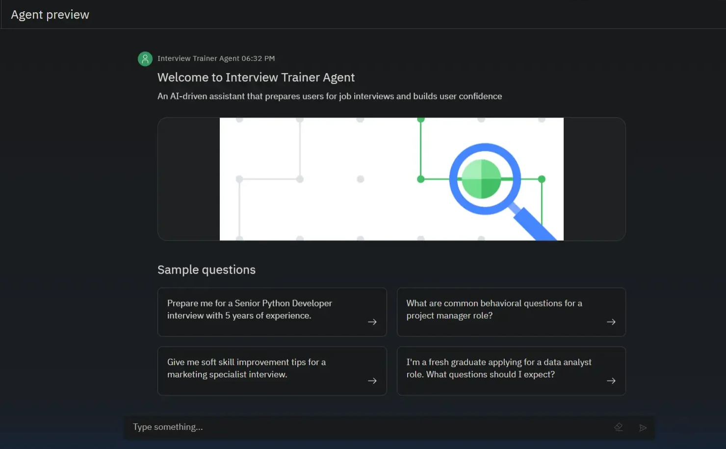
Results

Slide 9
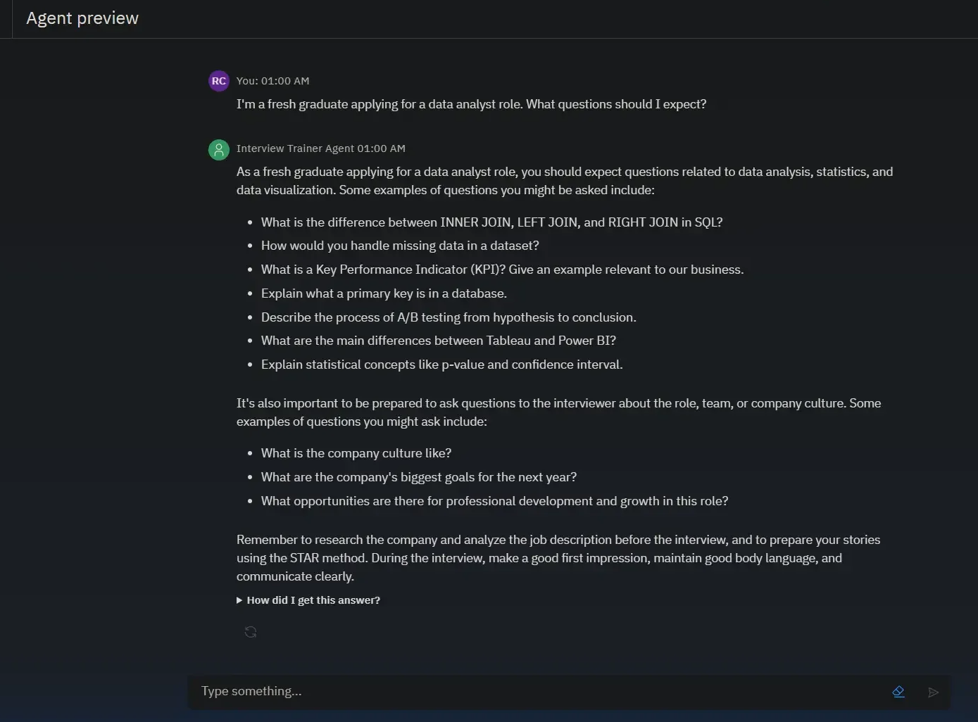
Results

Slide 10
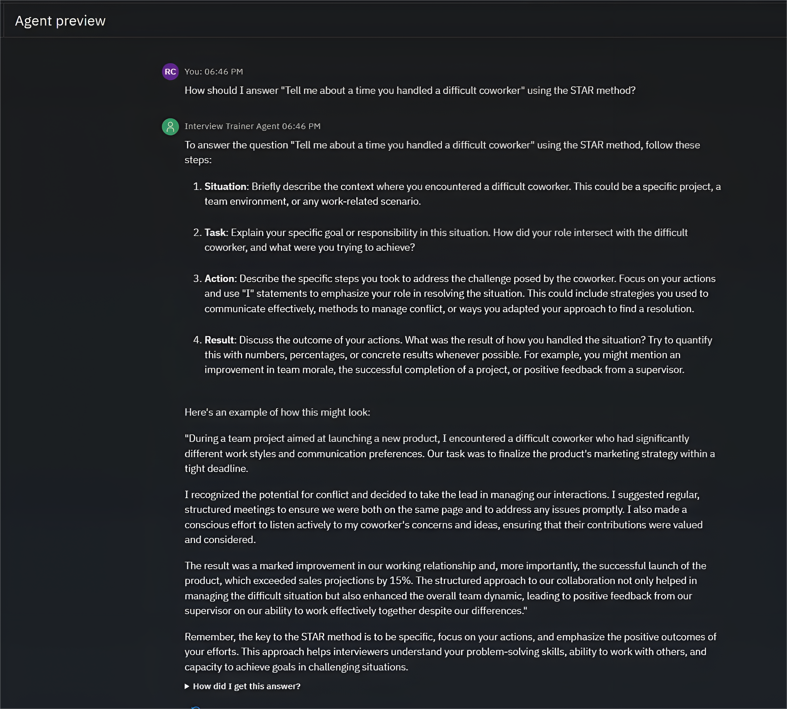
Results

Slide 11
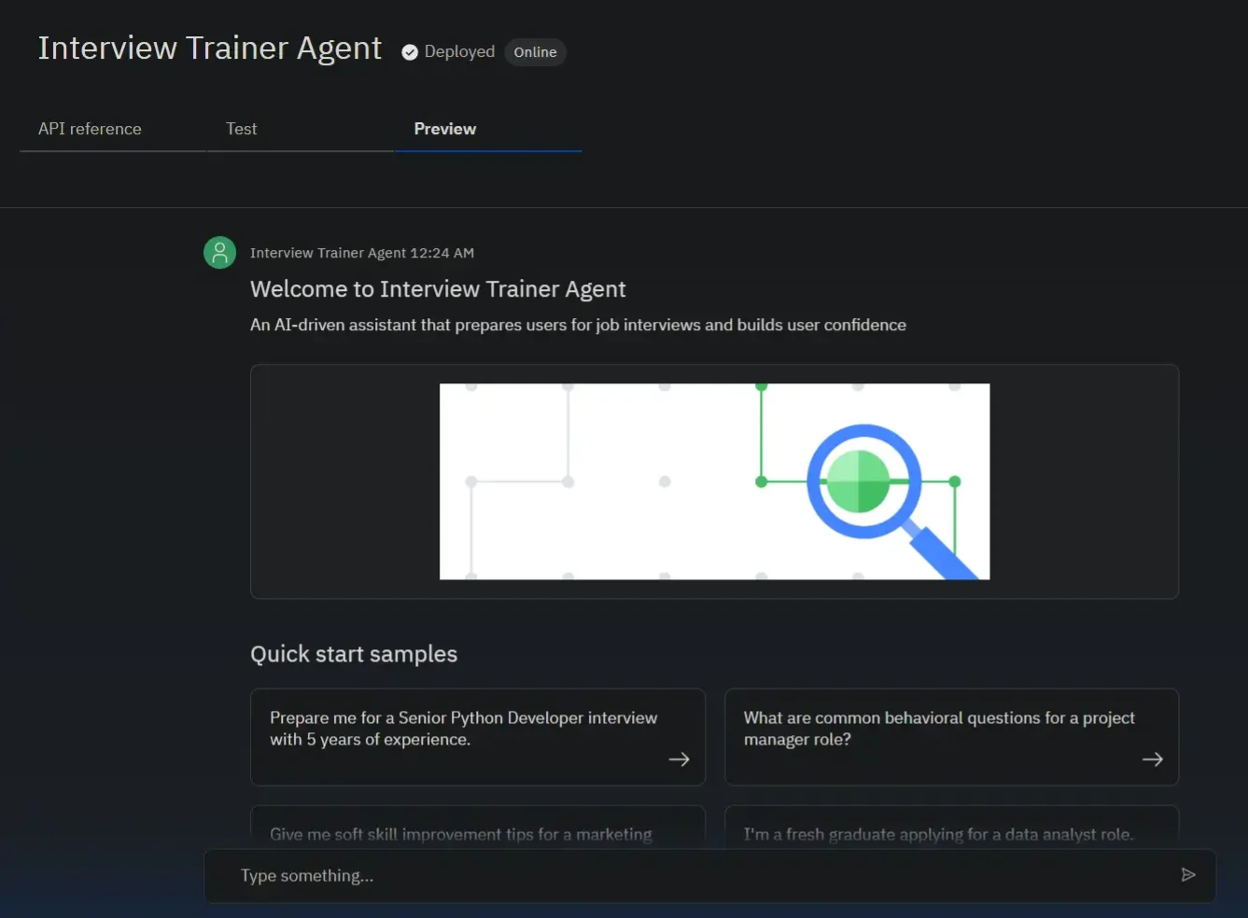
Results
Deployed AI Agent:

Slide 12
Conclusion
The agent successfully generates personalized and comprehensive interview preparation plans, addressing the specific needs of each user.
It saves users significant time by automating the research for relevant questions and providing structured, high-quality model answers.
By leveraging the IBM Granite model and RAG on watsonx.ai, the Interview Trainer Agent acts as a reliable and effective personal coach, enhancing user confidence and increasing their chances of success.

Slide 13
GitHub Link
Github repository link: https://github.com/Raj17deep/Interview-Trainer-Agent-IBM-Cloud

Slide 14
Future scope
Voice-Activated Mock Interviews: Implement voice capabilities for realistic, real-time interview simulations with feedback on tone and clarity.
Resume Analysis: Allow users to upload a resume to generate even more personalized questions based on their specific experience.
Company-Specific Intel: Integrate a tool to scrape a company's recent news and values to tailor preparation for a specific organization.
Performance Analytics: Track user progress across sessions and provide insights into areas needing improvement.
Integration with Job Platforms: Connect with platforms like LinkedIn to pull job descriptions and automatically generate prep plans.

Slide 15
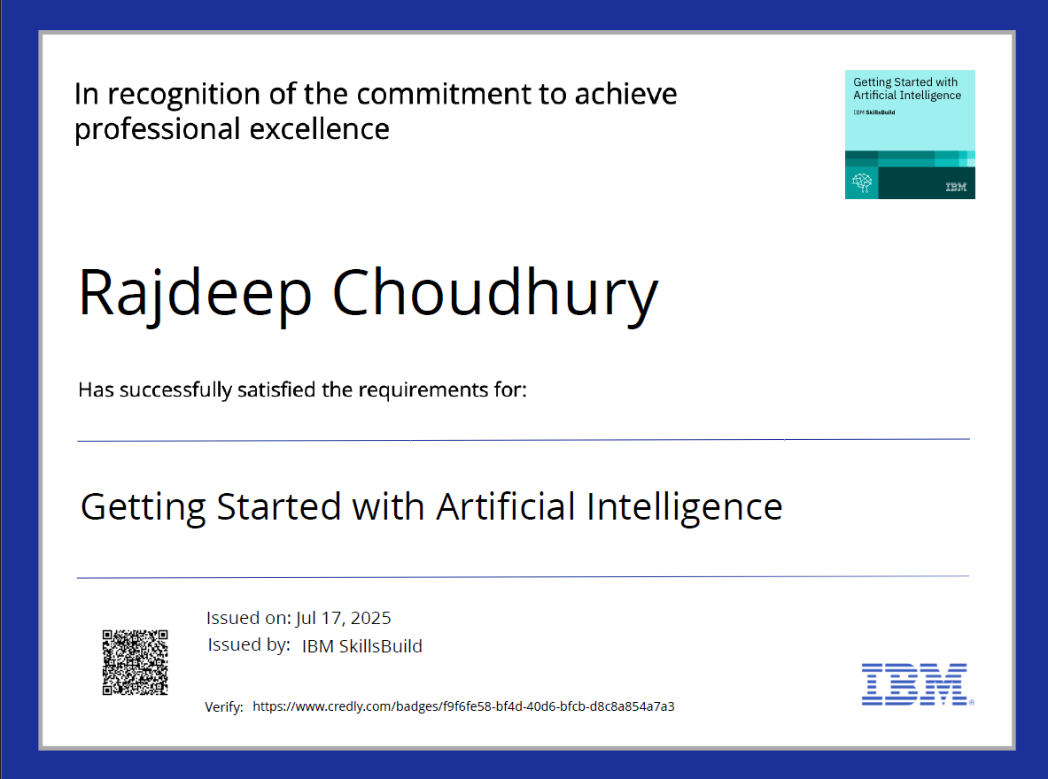
IBM Certifications

Slide 16
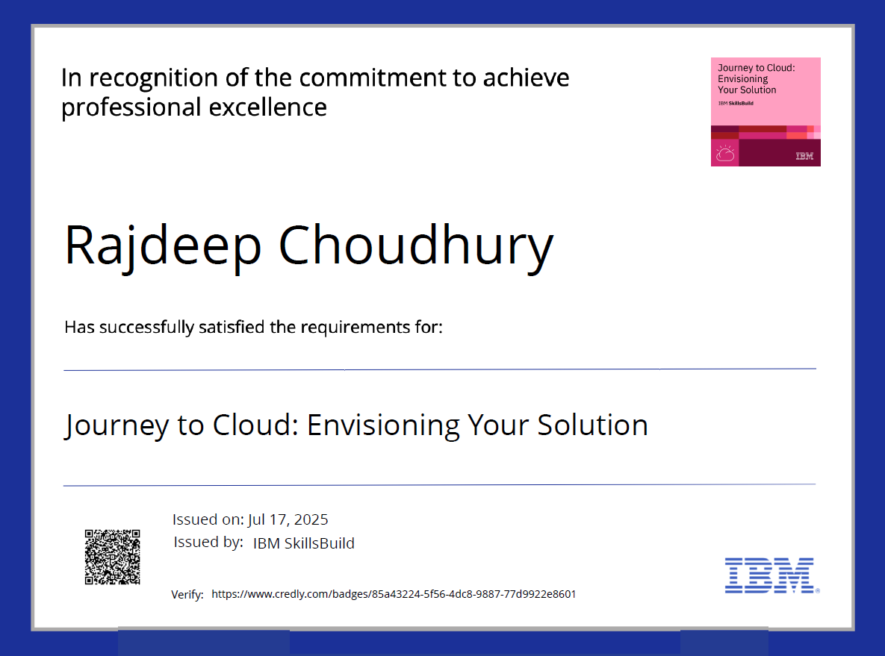
IBM Certifications

Slide 17
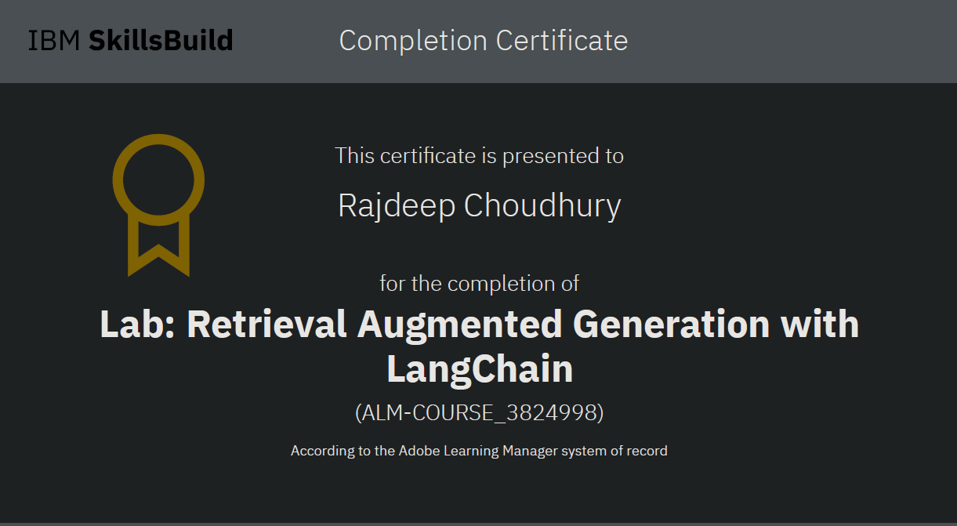
IBM Certifications

Slide 18
THANK YOU

